Slide 1
KNN-Based Cyber Crime
Detection in IoT Networks
An Extension of Veena & Meena (2022)
Applied to RT_IOT2022 Dataset by Vighnesh Raikar 25PG00119
K-Nearest Neighbors
IoT Security
RT_IOT2022
scikit-learn
Internal Assessment Submission | ML Classification & KNN Specialization

Slide 2
REFERENCE PAPER
02
"C SVM Classification and KNN Techniques for Cyber Crime Detection"
K. Veena, K. Meena et al. | Wireless Communications & Mobile Computing, Hindawi 2022 | DOI: 10.1155/2022/3640017
Problem
Methods
Detecting cybercrime using user-profile data from CBS open dataset; classifying users as genuine or criminal.
C-SVM (regularization-based) and KNN (distance-based) classifiers; Expectation Maximization for GMM evaluation.
Metrics
Findings
Accuracy, Precision, Recall, F1, Specificity, FPR, DR, Fowlkes-Mallows Scores, AUC-ROC, confusion matrix.
SVM achieved 98.8% and KNN 96.47% on 2000-sample test set; Optimizable KNN AUC = 0.92 with K=3.

Slide 3
RT_IOT2022 DATASET
03
123,117
85
12
Total Records
Features
Attack Types
IoT Network Flows
Network Traffic Columns
Multi-class Target
Attack Class Distribution
Dataset Highlights
Attack Type | Count | Protocol
DOS_SYN_Hping | 94,659 | TCP
Thing_Speak | 8,108 | TCP/UDP
ARP_Poisioning | 7,750 | ARP
MQTT_Publish | 4,146 | TCP/MQTT
NMAP Scans (4 types) | 7,630 | TCP/UDP
DDoS Slowloris | 534 | TCP
Wipro_bulb / Others | 290 | TCP
Real IoT traffic: MQTT, HTTP, CoAP protocols
Both benign & attack traffic included
3 protocol types: TCP (90%), UDP (10%), ICMP (<1%)
No missing values in dataset
LabelEncoded → 3 merged classes in experiment
Target: MQTT_Publish, Thing_Speak, Wipro_bulb

Slide 4
METHODOLOGY & PIPELINE
04
1
2
3
4
5
Load
Dataset
EDA &
Cleaning
Preprocessing
Train/Test
Split
KNN
Training
RT_IOT2022.csv
12,399 rows × 85 cols
(experimental subset)
No missing values
Check dtypes
Class distribution
LabelEncoder for target
StandardScaler + OneHotEncoder
→ 92 features
80% Train: 9,919
20% Test: 2,480
Stratified split
Initial K=5
Fit on X_train
Predict X_test
6
7
8
Cross-
Validation
Optimal K
Selection
Evaluate
Model
5-Fold KFold
Avg accuracy:
99.65%
K = 1 to 15
Best K = 2
Max acc: 98.17%
Accuracy: 99.40%
Confusion Matrix
Classification Report

Slide 5
HOW KNN WORKS
05
K-Nearest Neighbors (KNN)
Euclidean Distance Formula
d(x, y) = √ Σ (xᵢ − yᵢ)²
Non-parametric, instance-based learning algorithm
Classifies a new point by majority vote among K closest training points
Distance measured using Euclidean distance in feature space
No explicit training — model memorises the dataset
Sensitive to feature scale → StandardScaler is critical
Small K = overfit (noisy), Large K = underfit (smooth boundary)
Our optimal K = 2 found via 5-fold cross-validation sweep
where xᵢ, yᵢ are scaled feature values of two IoT network records
SVM vs KNN — Key Comparison
Criterion | SVM | KNN
Training | Required | None (lazy)
Prediction | Fast | Slower (dist)
Accuracy | 98.8% | 96.47–99.4%
Complexity | High | Low
IoT Fit | Moderate | Excellent

Slide 6
CODE IMPLEMENTATION
06
① Preprocessing
preprocessor = ColumnTransformer([
('num', StandardScaler(), num_cols),
('cat', OneHotEncoder(), cat_cols)
])
X_scaled = preprocessor.fit_transform(X)
# Shape: (12399, 92)
② Train & Evaluate (K=5)
knn = KNeighborsClassifier(n_neighbors=5)
knn.fit(X_train, y_train)
y_pred = knn.predict(X_test)
acc = accuracy_score(y_test, y_pred)
# Accuracy: 0.9940
③ Optimal K Selection
for k in range(1, 16):
knn = KNeighborsClassifier(n_neighbors=k)
scores = cross_val_score(knn, X, y, cv=5)
cv_scores.append(scores.mean())
# Best K=2, Accuracy=0.9817
Tools & Libraries Used:
Python 3
pandas
scikit-learn
matplotlib
numpy
Google Colab

Slide 7
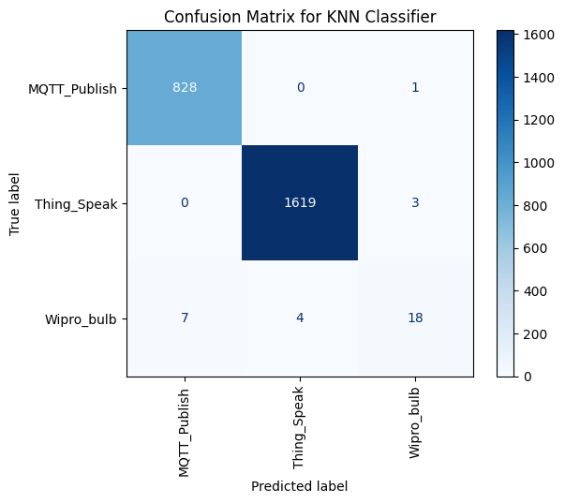
CONFUSION MATRIX
07
What the Matrix Shows
MQTT_Publish
Precision: 0.99 Recall: 1.00 F1: 1.00 Support: 829
Thing_Speak
Precision: 1.00 Recall: 1.00 F1: 1.00 Support: 1622
Wipro_bulb
Precision: 0.82 Recall: 0.62 F1: 0.71 Support: 29
Overall Accuracy: 99.40% | Weighted F1: 0.99 | Test Set: 2,480 samples
⚠ Wipro_bulb lower F1 due to class imbalance (only 29 samples in test set)

Slide 8
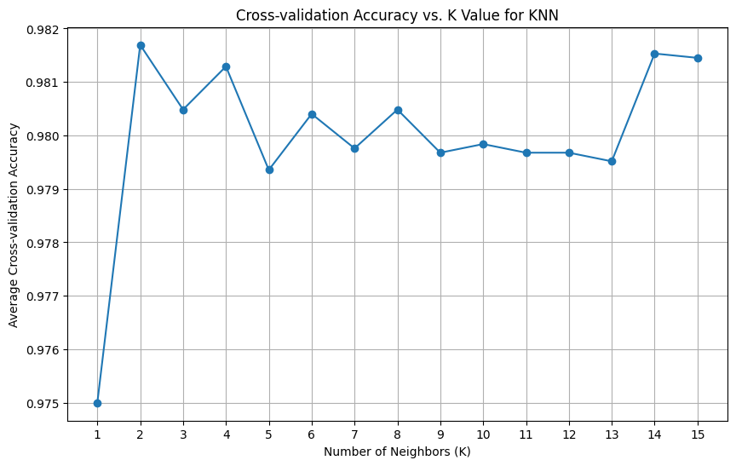
OPTIMAL K SELECTION & CROSS-VALIDATION
08
5-Fold Cross-Validation Results
Fold 1
0.9976
Fold 2
0.9980
Fold 3
0.9964
Fold 4
0.9960
Fold 5
0.9944
Mean CV Accuracy: 0.9965 (99.65%)
K vs CV Accuracy (K = 1 to 15)
1 | 2 | 3 | 4 | 5 | 6 | 7 | 8 | 9 | 10 | 11 | 12 | 13 | 14 | 15
97.50% | 98.17% | 98.05% | 98.13% | 97.94% | 98.04% | 97.98% | 98.05% | 97.97% | 97.98% | 97.97% | 97.97% | 97.95% | 98.15% | 98.15%

Slide 9
RESULTS & COMPARISON
09
99.40%
99.65%
K = 2
Test Accuracy
CV Accuracy
Optimal K
K=5, n=2480 samples
5-fold, full dataset
Max CV acc: 98.17%
Paper (Veena & Meena 2022) vs Our Extension
Aspect | Original Paper | Our Extension
Dataset | CBS Open Dataset (1000 users) | RT_IOT2022 (12,399 IoT records)
Features | 25 features, PCA applied | 83 numeric + 2 categorical = 92
KNN Accuracy | 96.47% | 99.40% (test) / 99.65% (CV)
K Used | Optimizable (K=3) | K=2 via systematic sweep 1–15
Validation | Single split | 5-fold cross-validation
Preprocessing | Standardize only | StandardScaler + OneHotEncoder

Slide 10
CONCLUSION & FUTURE WORK
10
KEY CONCLUSIONS
FUTURE DIRECTIONS
KNN with proper preprocessing achieves 99.40% accuracy on RT_IOT2022
Normalization (StandardScaler) is critical — features span very different scales
5-fold cross-validation confirms stable, generalisable performance (99.65%)
Optimal K = 2 outperforms the original paper's K = 3 setup
Simple, lightweight model suitable for real-time IoT edge deployment
Class imbalance (Wipro_bulb: 29 samples) causes lower F1 = 0.71
Apply SMOTE to fix class imbalance for Wipro_bulb
Use PCA to reduce 92 features and speed up prediction
Combine KNN with ensemble (Random Forest, XGBoost)
Deploy model on IoT edge device (Raspberry Pi)
Test on live real-time IoT network traffic
Compare with Deep Learning (LSTM, CNN) for IoT
Thank You · Questions Welcome
Paper: Veena & Meena (2022), Hindawi WCMC | Dataset: RT_IOT2022 | Tool: Python / scikit-learn / Google Colab

